Slide 1

Proactive Kubernetes Autoscaling for Dynamic Web Traffic Using Prophet and LSTM
By
Abd El-Aziz Mahmoud Abd El-Aziz Essa Student No.: 202301521
Supervised by: Dr. Ashraf Abdelmoumen Shahin
2025

Slide 2
Agenda
Introduction
Problem Statement
Objectives
Related Work
Proposed System Architecture
Forecasting Methodology
Experimental Setup
Results
Conclusion
Future Work

Slide 3
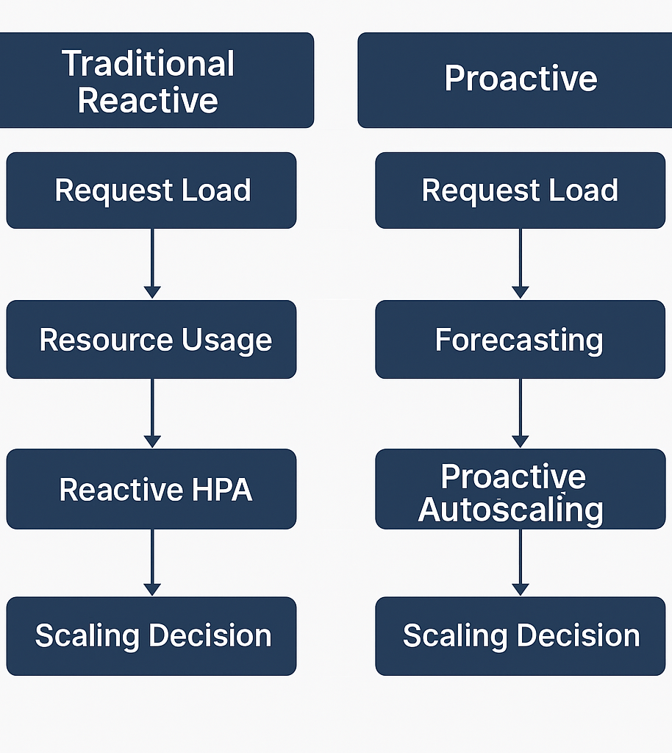
Introduction
Kubernetes is the standard for managing containerized applications.
The built-in Horizontal Pod Auto-scaler (HPA) is reactive and struggles with sudden demand spikes.
Proactive autoscaling forecasts future demand to improve response time and resource use.
This research develops a two-phase hybrid forecasting framework combining Prophet and LSTM.

Slide 4
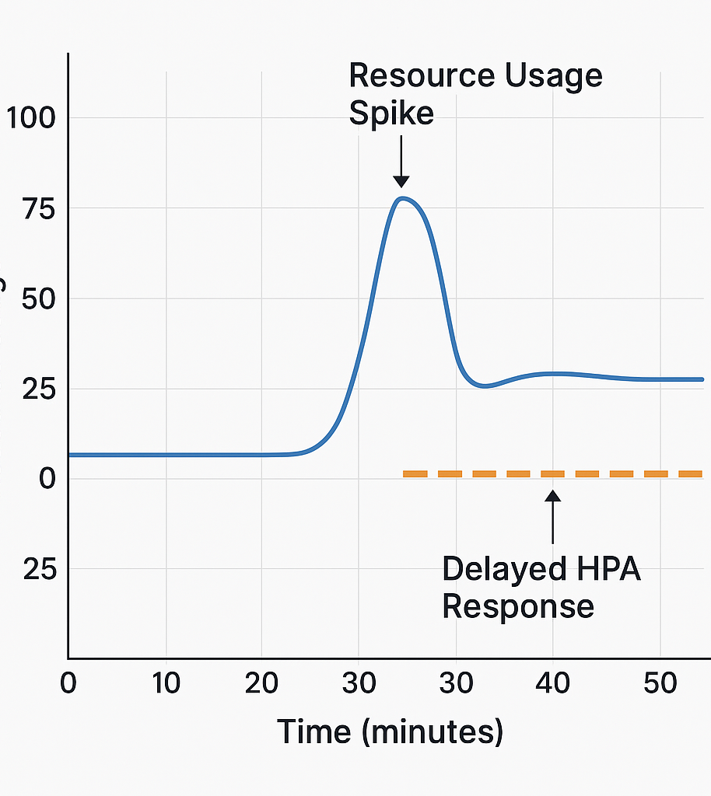
Problem Statement
HPA delays scaling until resource limits are breached, risking SLA violations.
Sudden or cyclical traffic patterns cause unpredictable spikes.
Need for a predictive system that enables early scaling to prevent performance degradation.

Slide 5
Related Work

Slide 6
Reference | Model / Technique | Strengths | Limitations
[1] Guruge & Priyadarshana (2025) | Prophet + LSTM | Captures trend + residuals, improves SLA compliance | Focused on periodic workloads only
[2] Mondal et al. (2023) | BiLSTM + Attention | High replica accuracy, responsive scaling | Limited to controlled deployments
[3] Alwakeel et al. (2023) | FLAS (forecast + reactive) | Balances elasticity with responsiveness | Manual threshold tuning required
[4] Liu et al. (2023) | AMAS (heuristic scaling) | Low resource waste, adaptable edge deployments | Not validated on bursty web traffic
[5] Karuna et al. (2023) | Multi-step LSTM | Effective peak forecasting | Sensitive to input variance
[6] Sarker et al. (2023) | LSTM + Q-learning | Dynamic policy learning, high SLA adherence | Complex training, high tuning overhead
[7] Chowdhury et al. (2025) | SmartHPA / ProSmartHPA | Fast convergence, better latency | Requires extensive historical data
[8] Park et al. (2023) | ANN Forecasting | Better than reactive HPA | Weak generalization under shifting loads
[9] Ma et al. (2024) | Marginal Request Change | Excellent spike detection accuracy | Depends on fine-tuned delta thresholds
[10] Trivedi & Panchal (2023) | Honey Badger Optimization | Cost-effective resource planning | Complex deployment process
[11] Liang et al. (2023) | Q-learning Autoscaler | Balances cost and performance, learns from history | Slow convergence, high data dependency
Summary of Related Work

Slide 7
Conclusion on Related Work
While prior models—including Prophet, LSTM, BiLSTM, Q-learning, and hybrid approaches—have made significant strides in improving Kubernetes autoscaling, each exhibited limitations when applied to dynamic, high-variance workloads.
This research addresses those gaps by integrating Prophet for long-term trend and seasonality detection with LSTM to model short-term nonlinear residuals. The proposed hybrid design offers improved generalization, responsiveness, and practical scalability in real-world web traffic environments.

Slide 8
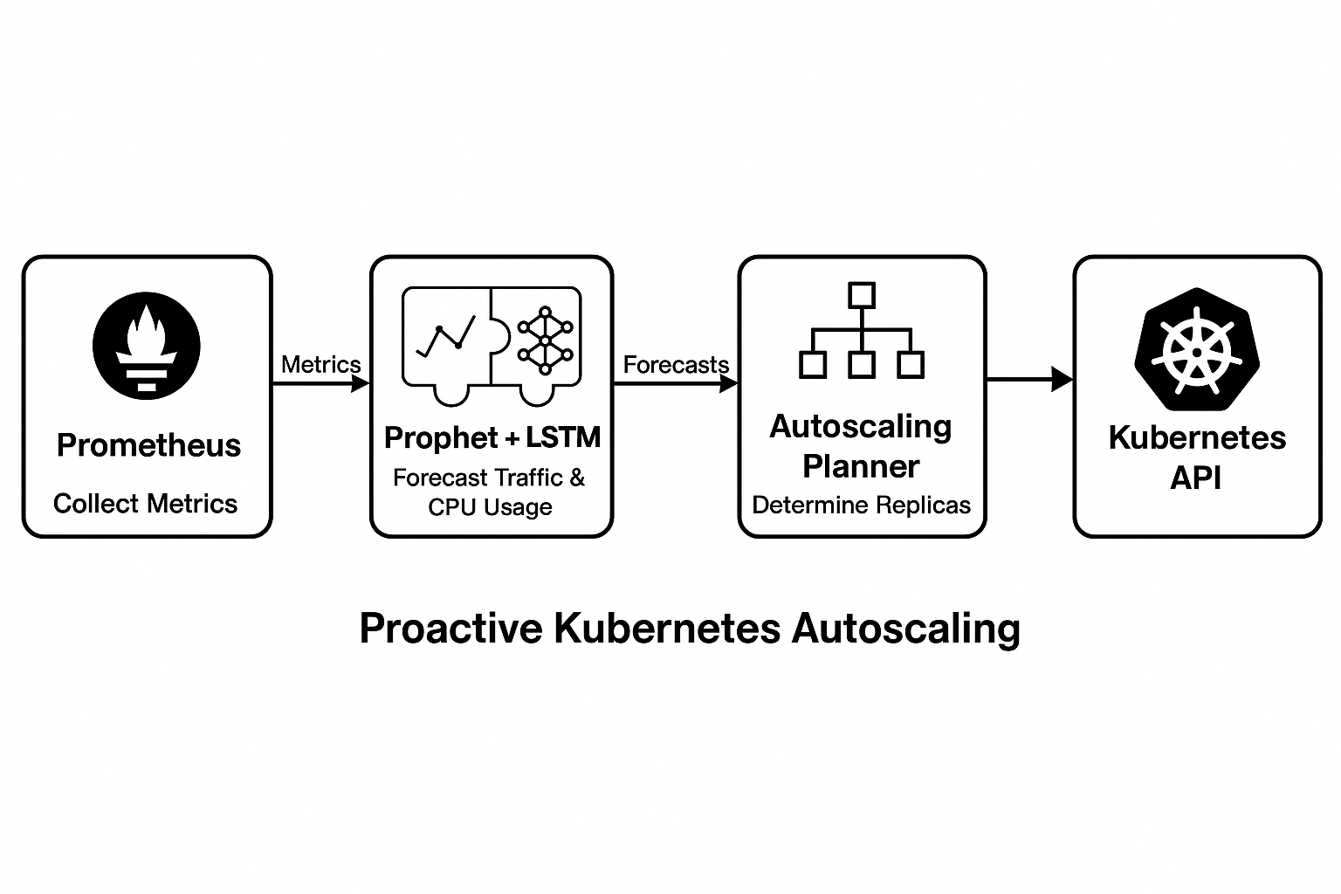
Proposed System Architecture
Modular pipeline with the following components:
Prometheus collects metrics
Prophet + LSTM forecast traffic and CPU usage
Autoscaling Planner determines needed replicas
Kubernetes API executes scaling decisions
Ensures low-latency, data-driven scaling.

Slide 9
Forecasting Methodology
Large Language Models (LLMs): GPT-4, LLaMA, PaLM
Key advances: Scaling, instruction-tuning, chain-of-thought
Phase 1: Prophet forecasts trends/seasonality. LSTM refines predictions using residuals.
Phase 2: Multi-output LSTM predicts CPU usage of 13 services using:
Past CPU data
Predicted request rate
Time encodings
Forecast Horizon: 1, 2, 5, 10, 15-minute ahead windows.

Slide 10
Experimental Setup

Slide 11
Datasets
usask.sec.min_short – Web traffic data
Workload_metrics_V2.csv – Custom Kubernetes workload metrics
Environment
Kubernetes on Minikube
Python (Prophet) and TensorFlow (LSTM)
Evaluation: MAE, RMSE, R², MAPE, Accuracy

Slide 12
Results
Phase 1:
Prophet-only achieved up to 99.9% accuracy on training and up to 49% on unseen data.
Prophet + LSTM reached 82.19% on 1-minute horizon using unseen data.
Phase 2:
LSTM predicted CPU for 13 services with >90% accuracy on most.
Best results for payment service (95.4%), shipping service, ad service.

Slide 13
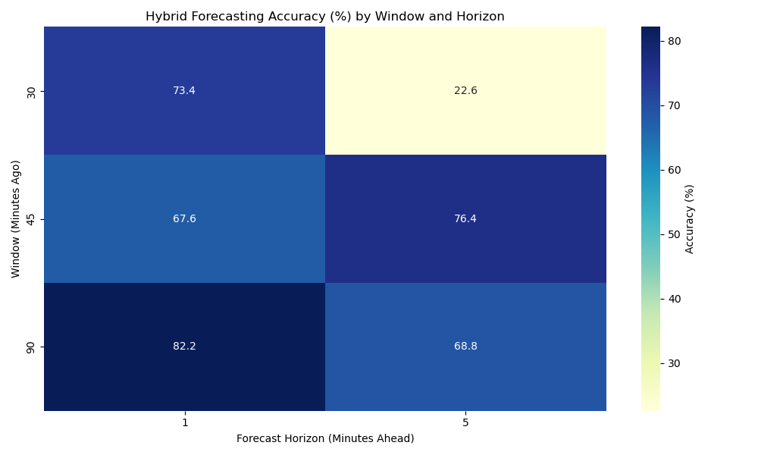
Phase 1 Accuracy heatmap

Slide 14
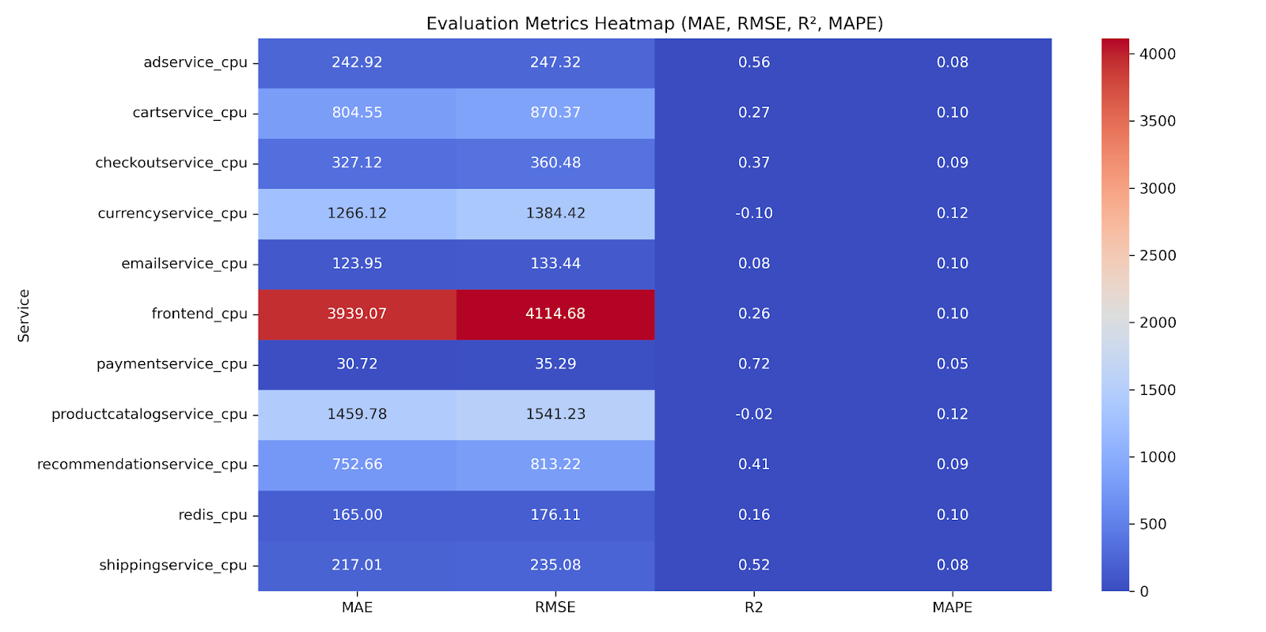
Phase 2 Evaluation metrics heatmap

Slide 15
Conclusion
Two-stage forecasting improved both responsiveness and forecast accuracy.
Hybrid models outperformed Prophet alone, especially in generalization.
Forecasts enabled early scaling decisions, reducing cold starts and SLA violations.
Takeaway: This system offers a scalable, proactive alternative to reactive Kubernetes HPA.

Slide 16
Future Work
Live Cluster Deployment: Real-time integration with custom auto-scaler.
Multivariate Expansion: Add memory/network forecasting.
Model Enhancement: Explore TCNs and attention-based models.
Online Learning: Handle concept drift with adaptive models.
Cost-Aware Scaling: Optimize for SLA and infrastructure cost.

Slide 17
References
[1] P. B. Guruge and Y. H. P. P. Priyadarshana, "Time Series Forecasting-Based Kubernetes Autoscaling Using Facebook Prophet and Long Short-Term Memory," Frontiers in Computer Science, vol. 7, 2025.
[2] A. Mondal et al., "Stable and Efficient Resource Management Using Deep Neural Network on Cloud Computing," Neurocomputing, vol. 540, pp. 125841, 2023.
[3] A. Alwakeel et al., "FLAS: A Combination of Proactive and Reactive Auto-Scaling Architecture for Distributed Services," Journal of Network and Computer Applications, vol. 210, 2023.
[4] L. Liu et al., "AMAS: Adaptive Auto-Scaling for Edge Computing Applications," IEEE Access, vol. 11, 2023.
[5] R. Karuna et al., "Predictive Auto-scaling: LSTM-Based Multi-Step Cloud Workload Prediction," ICSOC Workshops, 2023.
[6] R. Sarker et al., "Auto-Scaling Cloud Resources Using LSTM and Reinforcement Learning," Future Generation Computer Systems, vol. 147, 2023.
[7] Lawrence Berkeley National Laboratory, The Saskatchewan HTTP Trace. [Online]. Available: https://ita.ee.lbl.gov/html/contrib/Sask-HTTP.html
[8] A. Essa, Workload_metrics_V2.csv: Custom dataset collected from a Kubernetes-based microservices application deployed on Google Cloud Platform, 2025. [Unpublished dataset].
[9] A. Essa, Hybrid Forecasting for Kubernetes Autoscaling (Phase 1 & 2). GitHub repository, 2025. [Online]. Available: https://github.com/Abdelazizessa77/Hybrid_Forecasting_for_Kubernetes_Autoscaling

Slide 18
Thank you
Abdelaziz Mahmoud Essa
Abdelaziz.essa77@gmail.com

